Slide 1
Continual Learning Techniques for Image Classification
Finlay Boyle
Supervised by Dr Donald Sturgeon
Durham University, Department of Computer Science
Notes:
Continual Learning Techniques for Image Classification

Slide 2
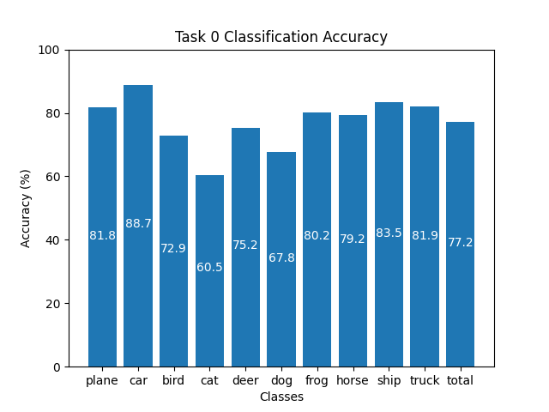
Training Machine Learning Models
Standard method of training models is known as Offline Training
Repeatedly optimise over batches of data from the dataset
Requires access to all of the data for the whole training process
Capable of producing high-quality results
Some limitations exist:
What if the data is not all readily available?
What if it is too expensive or infeasible to store all of the data?
Figure 1: Offline Training on CIFAR-10 for 100 epochs
Notes:
Talk about Offline Training and its requirements
Talk about the graph
High quality results with minimal effort
No LR tuning etc
Limitations
So much real time data these days
Can be too expensive to store and use all of it
Neural networks inspired by animals/humans but continual learning overlooked
Raises the question: what happens if Offline Training is used to update the model with new data?

Slide 3
Catastrophic Forgetting
Catastrophic Forgetting: a phenomenon were a neural network overwrites any existing knowledge in the network when training on new data [1]
Occurs when naively using Offline Training to update an already trained neural network about new classes sequentially
Offline Training does not preserve the existing knowledge in the network
Training process does not have the context that the existing weights in the network represent prior knowledge
Can view them as an initialisation of the network instead
Inspiration for neural networks comes from nature [2] but ability to learn continuously is often overlooked
Notes:
Offline training causes catastrophic forgetting
No context that the existing weights of the network is pre-existing knowledge
Unable to preserve the existing knowledge

Slide 4
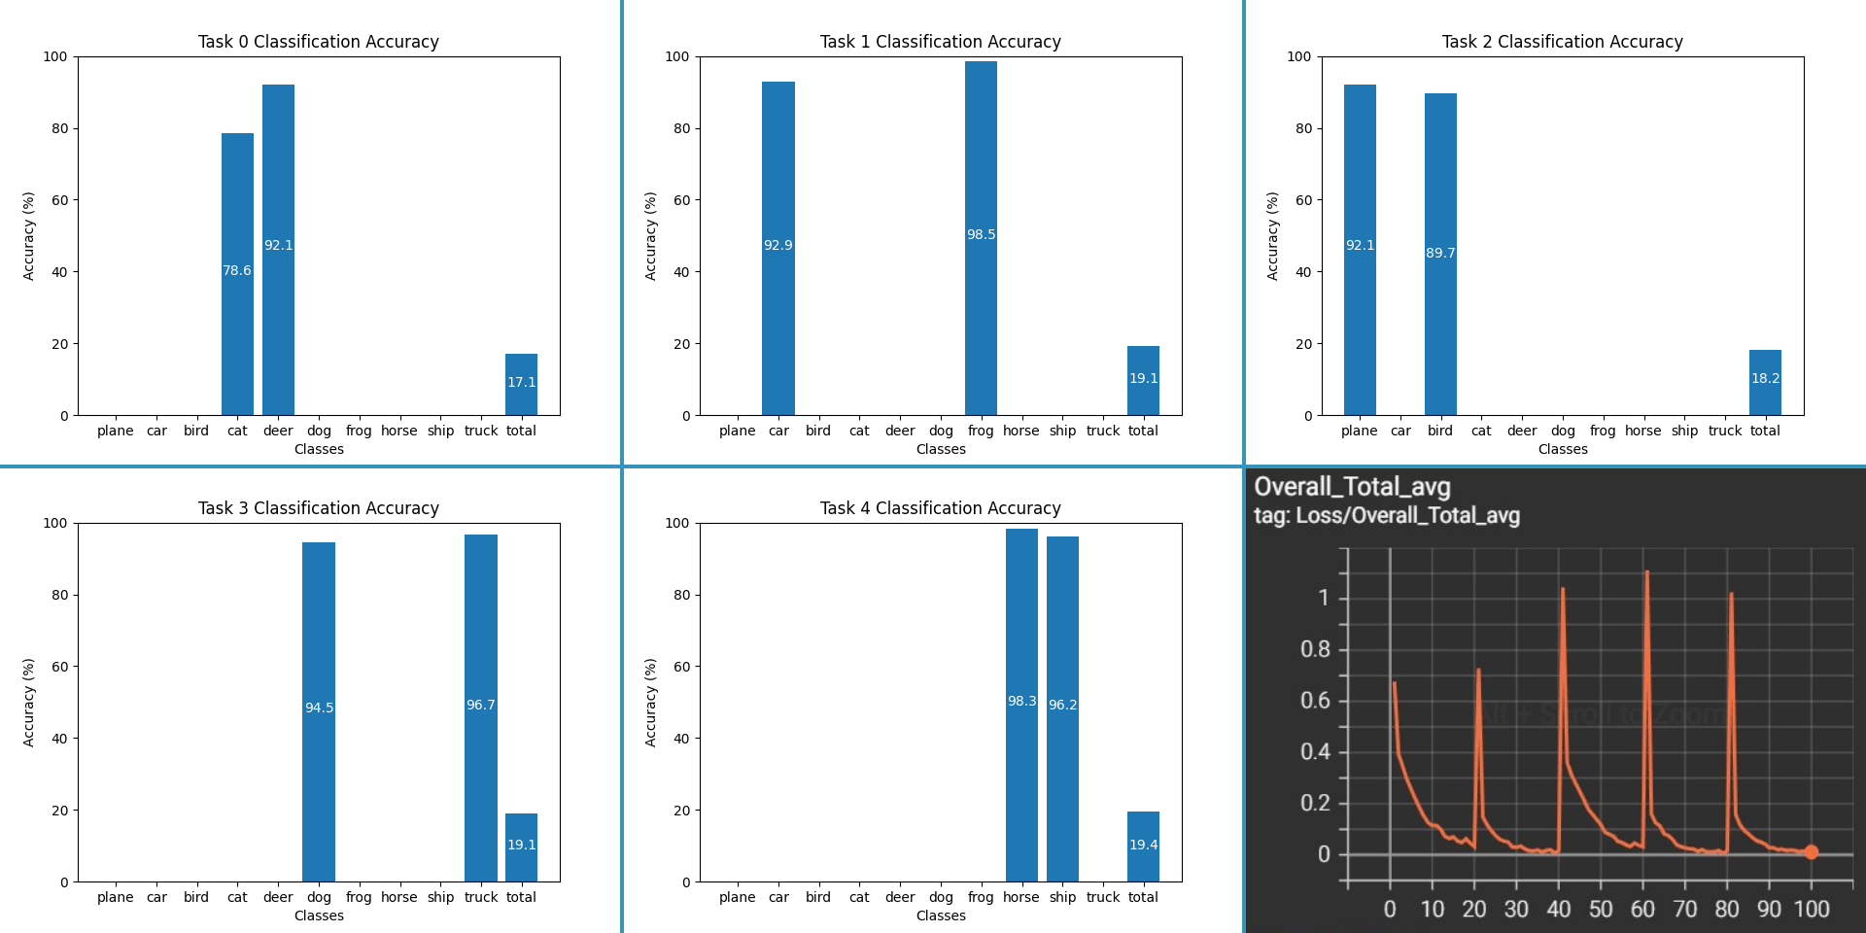
Example of Catastrophic Forgetting
Figure 2: Applying Offline Training on the same model with separate tasks causes Catastrophic Forgetting. Bottom right: Overall loss, other images are classification accuracy
Notes:
An experiment showcasing Catastrophic Forgetting
Trained the same network sequentially on CIFAR-10 split into 5 tasks
Each task contains 2 classes, each task is completely disjoint
Attains high classification accuracy on the classes in the task
Overwrites the knowledge already acquired
Leads to very poor overall classification accuracy

Slide 5
Continual Learning
Continual Learning attempts to overcome Catastrophic Forgetting [3]
Is it possible to train a network sequentially while maintaining knowledge?
Primarily focused on alternative methods to Offline Training
Smaller focus on network architecture and dynamic networks
Difficulty of the Continual Learning problem depends on the setup of the problem
Core difference from Offline Training is the removal of the requirement of the whole dataset
Rose to prominence with Elastic Weight Consolidation in 2017 [4] and is actively researched
Notes:
CL is the field that attempts to overcome these issues
Aims to preserve prior knowledge while training sequentially
Most of the literature focuses on alternatives to Offline Training
Smaller focus on network architecture
Setup of the continual learning problem is important – will cover this later on
Concept that links all techniques is not requiring the whole dataset at the same time
Rose to prominence with Elastic Weight Consolidation
Maybe a quick description of this?

Slide 6
Applications of Continual Learning
Continual Learning offers real-world benefits
Models trained on massive amounts of data are expensive to train [5] in terms of energy usage, computational resources, and time
Retraining these models to update them with new data compounds the cost
If they can be updated with Continual Learning this could save computational resources and time such as in Image Classification [6]
Real-time applications can also benefit by adapting to the changing data distribution leading to more accurate results
Research is mainly focused on Image Classification but can be applied to other domains such as Natural Language Processing [7]
Notes:
Real-world benefits
Reduction in energy usage, computational resources, and time
Retraining models from scratch compounds cost
CL offers chance to reduce these costs
Real-time training benefits
Image Classification primary focus but NLP also possibility

Slide 7

Setup for Continual Learning
The setup of the problem for Continual Learning is vital to ensure results are real-world applicable
Issues with the direction of the literature were highlighted by the authors of a simplistic technique called GDumb [8]
Assumptions affecting the setup:
Online vs Offline
Disjoint Tasks vs Non-Disjoint Tasks
Class Incremental vs Task Incremental
Resource Constraints
Figure 3: Disjoint Task Formulation with 3 classes per task
Figure 4: Non-disjoint Task Formulation with all 6 tasks in any order
Notes:
As mentioned previously
Vital to ensure results are real-world applicable
Issues were highlighted in the literature by GDumb
Simplistic because it does not take a necessarily specialised approach to the problem but still achieves highly competitive performance
Multiple factors affecting the setup, difficulty determined by their combination
Online vs Offline
Online assumes the data is streamed continuously and not fixed
Offline, like Offline Training, assumes access to the data at all times
Offline mostly defeats the point of Continual Learning and voids the benefits
Online is preferred
Disjoint vs Non-disjoint
Disjoint task formulations partition the problem into classes with distinct classes in
No overlap between tasks
Requires knowing all of the classes in advance so they can be partitioned
Non-disjoint is more real-world applicable
Many techniques do use the disjoint task formulation and it can have applications
Class-IL vs Task-IL
Task-IL use the disjoint formulation but at inference time the model is told which task the sample to be classified belongs to, drastically reduces the difficultly since it limits the classes
Class-IL, can use disjoint or non-disjoint tasks, is the preferred formulation, at classification time the model is given no additional information – just the sample to classify and that’s all
Resource consumption
Some techniques store samples from the data stream (this doesn’t violate Online assumption)
Necessary to impose constraints on how much can be stored etc

Slide 8
Part I: Literature Evaluation
My project will initially focus on implementing and evaluating existing techniques from the literature
Aim is to provide a robust comparison between existing methods to solve some of the issues outlined previously
Deliverables:
Implementation of Baselines: Finetuning and Offline Training
Historical Techniques: Elastic Weight Consolidation [4], iCaRL [9]
State of the Art: GDumb [8], Rainbow [10], Mnemonics [11]
Cutting Edge: Learning to Prompt [12] and meta-learning techniques
Evaluation and comparison of techniques
Notes:
Implementing and comparing techniques
Idea is a robust evaluation
Baselines:
Offline Training – as previously covered, provides an upper bound and the goal is to match this performance
Finetuning – Similar to the example of catastrophic forgetting shown before. Simply train the model (using traditional techniques) on the incoming samples and then discard them. Represents the lower bound as this will cause catastrophic forgetting. If we did worse than this then no point!
Historical techniques:
Important techniques that are often referenced in the literature and provide CL specific baselines as new techniques should beat these
Elastic Weight Consolidation – mentioned previously. Falls into a type known as regularisation techniques that penalise weight changes to preserve knowledge. Fallen out of favour in recent literature
State of the Art:
Current best approaches, can be difficult to truly identify due to the issues in the literature outlined previously
GDumb – mentioned previously, stores a balanced subset of the data and then trains a classifier at inference time on these samples. Shown good performance. Part of replay methods
Replay methods are the current forefront
Rainbow – Aims to sample data that is representative of its own class but discriminative against others
Mnemonics – Aims to
Cutting Edge:
Present new approaches and ideas, will feed into the second part of the project
L2P – Provides small prompts that are learned during the training process that are prepended to the input prior to classification
Meta-learning – learns how to preserve knowledge during training

Slide 9
Part II: Novel Experimentation
After literature comparison and evaluation, the focus will shift to gaps in the literature
Aim is to experiment with potential future research areas and potentially create a novel approach.
This will be influenced by the cutting-edge techniques e.g. experimenting with architecture [13] and sampling methods for replay methods
Deliverables:
Establishing a theoretical underpinning to any experimentation to ensure there exists potential
Implementation of experiments and potentially any different approaches found
Evaluation and comparison with techniques from Part I
Notes:
Focus on gaps in the literature
Explore potential future research areas with aim to contribute something novel
Influenced by cutting edge techniques as well as other literature such as:
Experimenting with architecture which has shown potential
Sampling techniques
More?
Deliverables:
Explaining theoretical underpinning
Implementation
Evaluation and comparison

Slide 10
References
[1] McCloskey, Michael, and Neal J. Cohen. "Catastrophic interference in connectionist networks: The sequential learning problem." Psychology of learning and motivation. Vol. 24. Academic Press, 1989. 109-165.
[2] Hecht-Nielsen, Robert. "Neurocomputing: picking the human brain." IEEE spectrum 25.3 (1988): 36-41.
[3] Parisi, German I., et al. "Continual lifelong learning with neural networks: A review." Neural Networks 113 (2019): 54-71.
[4] Kirkpatrick, James, et al. "Overcoming catastrophic forgetting in neural networks." Proceedings of the national academy of sciences 114.13 (2017): 3521-3526.
[5] Wiggers, Kyle. "AI Weekly: AI Model Training Costs on the Rise, Highlighting Need for New Solutions." VentureBeat, 15 Oct. 2021, https://venturebeat.com/ai/ai-weekly-ai-model-training-costs-on-the-rise-highlighting-need-for-new-solutions/.
[6] Mai, Zheda, et al. "Online continual learning in image classification: An empirical survey." Neurocomputing 469 (2022): 28-51.
[7] Biesialska, Magdalena, Katarzyna Biesialska, and Marta R. Costa-Jussa. "Continual lifelong learning in natural language processing: A survey." arXiv preprint arXiv:2012.09823 (2020).
[8] Prabhu, Ameya, Philip HS Torr, and Puneet K. Dokania. "Gdumb: A simple approach that questions our progress in continual learning." European conference on computer vision. Springer, Cham, 2020.
[9] Rebuffi, Sylvestre-Alvise, et al. “iCaRL: Incremental classifier and representation learning." Proceedings of the IEEE conference on Computer Vision and Pattern Recognition. 2017.
[10] Bang, Jihwan, et al. "Rainbow memory: Continual learning with a memory of diverse samples." Proceedings of the IEEE/CVF Conference on Computer Vision and Pattern Recognition. 2021.
[11] Liu, Yaoyao, et al. "Mnemonics training: Multi-class incremental learning without forgetting." Proceedings of the IEEE/CVF conference on Computer Vision and Pattern Recognition. 2020.
[12] Wang, Zifeng, et al. "Learning to prompt for continual learning." Proceedings of the IEEE/CVF Conference on Computer Vision and Pattern Recognition. 2022.
[13] Mirzadeh, Seyed Iman, et al. "Architecture matters in continual learning." arXiv preprint arXiv:2202.00275 (2022).

